Slide 1


Predicting Renewable Energy Generation Using Machine Learning
Institute of Advanced Computing and Software Development, Pune
Post Graduation Diploma in Big Data Analytics
Feb-20
Group-11
By :
Abhinav Giradkar -1319
Akshay Shivtare –1346
Project Guide :
Mr. Akshay Tilekar

Slide 2
Contents
Goals and Objectives
Problem Statement
Data Collection
Dataset
Exploratory Data Analysis
Model and Algorithms
Results
Conclusion

Slide 3
Goals and Objective
To find out the Renewable Energy generation on the basis of Weather forecasting.
In this Project, we are going to predict the Solar and Wind Generation by taking the co-related features from the weather data.
The main objective is to use different machine learning algorithm (Take the best model) and predict the wind and solar generation.

Slide 4
Problem Statement
In renewable energy generation process, energy production depends on the weather forecasting.
Renewable energy resources like solar ,wind are highly variable and the resulting fluctuations in the generation capacity can cause instability in the power grid. This is because the power output of these plants is defined by the environmental factors such as wind speed, the intensity of solar radiation, cloud cover and other factors.
Limitation of renewable energy power plants is that they are subject to marked daily and annual cycles (e.g., solar energy is only available during the day). Thus, it is necessary to generate power when resources are available and store it for later use while using a certain portion of the generated power at the same time.
So, the above limitation challenges to use the machine learning techniques for supporting better management of energy generation and consumption. So, the machine learning techniques help to predict the generation for future power use and also to preserve the energy in a bad situation.

Slide 5
Data Collection
The data used in this analysis come from Open Power System Data, a free-of-charge platform with data on installed generation capacity by country/technology, individual power plants (conventional and renewable), and time series data.
The platform contains data for 37 European countries, but in this project we are going to focus on data for Germany in 2016.
There are two .csv files use in this project:
Time series with load, wind and solar, prices in hourly resolution contains 8784 rows and 2 columns.
Weather data with wind speed, radiation, temperature and other measurements. Given the huge amount of data, the Open Power System Data platform provides a CSV file for the German dataset for 2016 contains 2.2 million rows and 14 columns.

Slide 6
Dataset
The Weather data in the weather.csv file contains the following:
Wind parameters:
- v1: velocity [m/s] @ height h1 (2 meters above displacement height)
- v2: velocity [m/s] @ height h2 (10 meters above displacement height)
- v_50m: velocity [m/s] @ 50 meters above ground
- h1: height above ground [m] (h1 = displacement height +2m)
- h2: height above ground [m] (h2 = displacement height +10m)
- z0: roughness length [m]
Solar parameters:
- SWTDN: total top-of-the-atmosphere horizontal radiation [W/m²]
- SWGDN: total ground horizontal radiation [W/m²]
Temperature data:
- T: Temperature [K] @ 2 meters above displacement height (see h1)
Air data:
- Rho: air density [kg/m³] @ surface
- p: air pressure [Pa] @ surface
The Generation data in the generation csv file contains the following:
Actual_solar_generation
Actual_wind_generation

Slide 7
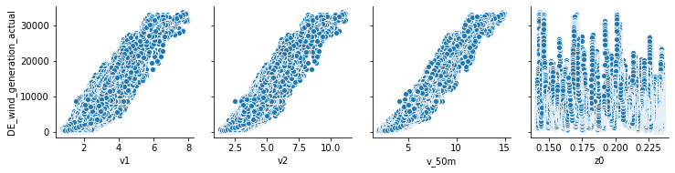
Exploratory Data Analysis 1.Wind Generation Correlation

Slide 8
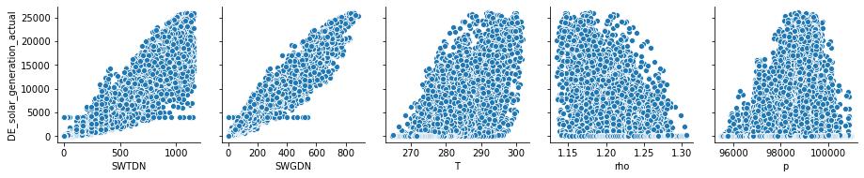
Exploratory Data Analysis 2.Solar Generation Correlation

Slide 9
Model and Algorithms
Algorithms :
Linear Regression
KNN Regression
Ridge Regression
ElasticNet Regression
Bagging Regression

Slide 10
All Model’s r2_score & Best Fit Model
Models | Wind r2_score | Solar r2_score
1.Linear Regression | 0.9055 | 0.9552
2. KNN Regression | 0.9112 (k=18) | 0.9586 (k=19)
3. Ridge Regression | 0.9054 | 0.9584
4. ElasticNet Regression | 0.9054 | 0.9552
5. Bagging Regression | 0.9542 | 0.9574

Slide 11
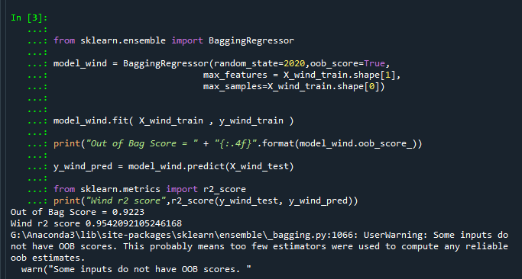
Results
Results of Best fit model (Bagging Regressor)
FOR WIND GENERATION :

Slide 12
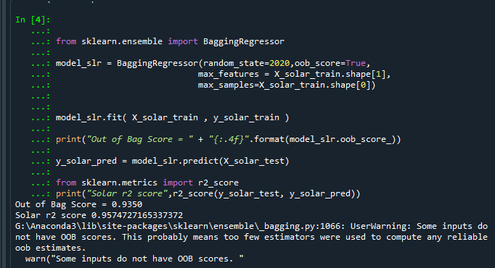
Results
Results of Best fit model (Bagging Regressor)
FOR SOLAR GENERATION :

Slide 13
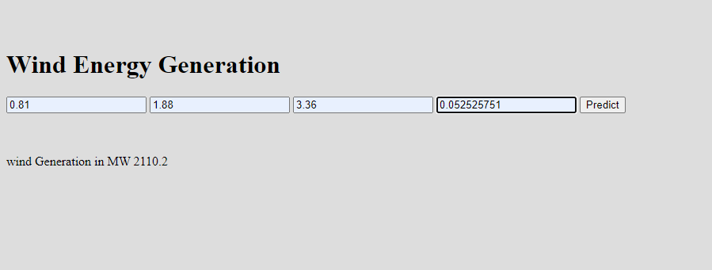
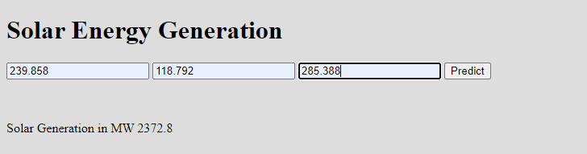
Prediction On User Interface :
For deployment of model,
Wind Energy and Solar Energy Generation Prediction On User Interface :

Slide 14
Future Scope :
The Non-renewable energy is limited resources that will eventually run out over the time frame and it also causes pollution in the environment. Thus, the thermal power plant is get shutdown in future scenario.So, all the power generation is shifted to renewable energy generation.
In future, this project is also deployed to predict the generation of power from the hydro energy as well as tidal energy on the basis of hydro energy parameters and the tidal energy parameters .

Slide 15
Conclusion
Wind and solar are also promising renewable sources that have experienced a fast pace of growth in the recent years. An inherent feature of these resources is that the energy production capacity is not fully controllable or even predictable, So, to give the proper prediction about the renewable energy generation is really helpful for the power plant authorities.
After applying the different models we have found that the Bagging Regressor is the best fit model for predicting the Renewable energy generation with overall r2_score of 95.42% for Wind Generation and 95.74% for Solar Generation.

Slide 16
THANK YOU

